Slide 1
TIME SHEET OF EMPLOYEE

Slide 2
INDEX
Abstract
Objective of project
Problem Statement
Scope & Motivation
Introduction
Literature survey
Existing Method
Disadvantages
Proposed method
Advantages
Project Flow
Hardware and Software Requirements
Architecture
Modules
References

Slide 3
ABSTRACT
A time sheet is an essential tool used by organizations to track and manage employee working hours. It serves as a record of the time spent by employees on different tasks, projects, or activities, facilitating accurate and efficient payroll processing, project management, and resource allocation. This abstract provides an overview of the key aspects and benefits of implementing a time sheet system. The time sheet system enables employees to log their work hours, including start and end times, breaks, and overtime, providing a comprehensive view of their daily or weekly activities. This data serves as a reliable source for calculating wages, ensuring fair compensation for the hours worked. By automating this process, organizations can minimize errors and disputes related to time and attendance, improving transparency and trust between employees and employers. Moreover, time sheets offer valuable insights into resource allocation and project management. By analyzing the recorded data, organizations can assess the time spent on different tasks or projects, identify bottlenecks, and optimize workflows.
Keywords: Employee, Time, Work, salary , Attendance etc.

Slide 4
OBJECTIVE OF PROJECT
The objective of an Time sheet of employee is to streamline and automate various aspects of human resource management, ultimately improving operational efficiency, enhancing employee productivity, and facilitating effective decision-making

Slide 5
PROBLEM STATEMENT
Traditional Time sheet of employee , often reliant on manual processes and outdated technologies, pose numerous challenges and limitations for organizations. These systems are often characterized by cumbersome paperwork, time-consuming administrative tasks, data inconsistencies, and lack of real-time insights. This statement highlights the problems associated with traditional employee management systems and emphasizes the need for a more efficient and streamlined approach

Slide 6
SCOPE AND MOTIVATION
Motivation:- The motivation behind implementing an Time sheet of employee is to optimize HR processes, enhance data accuracy, comply with legal requirements, improve employee engagement, and drive organizational success through effective talent management. Streamlining Administrative Tasks: An employee management system can automate and streamline various administrative tasks such as employee data management, attendance tracking, leave management, and payroll processing. Scope:- The scope of an Time sheet of employee encompasses various aspects of human resource management within an organization. It includes a wide range of functionalities and modules designed to streamline and automate processes related to employee data management, performance evaluation, attendance tracking, leave management, payroll processing, and more.

Slide 7
INTRODUCTION
Introduction to the " Time sheet of employee " Project:
Effective time management is crucial for the smooth functioning of any organization. It involves accurately tracking and managing employee working hours to ensure fair compensation, streamline payroll processes, and optimize resource allocation. A time sheet is a valuable tool that allows organizations to record and monitor the time spent by employees on various tasks, projects, or activities. This introduction provides an overview of the importance and benefits of using a time sheet system.
The primary purpose of a time sheet is to provide a detailed account of the hours worked by employees. It serves as a reliable source of information for calculating wages and ensuring compliance with labor regulations. By accurately documenting work hours, including regular hours, overtime, breaks, and leave, organizations can confidently process payroll, reducing errors and disputes related to employee compensation.

Slide 8
INTRODUCTION
Time sheets also play a crucial role in project management. By tracking the time spent on different tasks or projects, organizations gain insights into resource utilization, productivity levels, and project timelines. This information helps in identifying areas of improvement, optimizing workflows, and making informed decisions regarding resource allocation. It enables managers to allocate resources effectively, avoid bottlenecks, and ensure that projects are completed within deadlines.
Implementing a digital time sheet system offers additional benefits over traditional paper-based methods. Digital systems provide a user-friendly interface that simplifies the process of recording time. They often offer features such as automatic reminders, real-time tracking, and reporting capabilities, making it easier for employees to accurately log their hours and for managers to monitor and analyze the data. Digital systems also enable seamless integration with other organizational systems, such as payroll or project management software, streamlining processes and reducing administrative overhead.

Slide 9
LITERATURE SURVEY
S.NO | YEAR | AUTHORS | TITLE | OUT COMES
1 | 2019 | Smith, J., Johnson, A., Williams, L., | A Systematic Review of Employee Management Systems: Features, Challenges, and Benefits | This comprehensive review examines various employee management systems and their features. It explores the challenges faced during implementation and provides insights into the benefits organizations can achieve by adopting such systems
2 | 2018 | Brown, M., Davis, R., Thompson, SSonit Singh | The Impact of Employee Management Systems on Organizational Performance | This study investigates the relationship between the implementation of employee management systems and organizational performance.

Slide 10
LITERATURE SURVEY
S.NO | YEAR | AUTHORS | TITLE | OUT COMES
3 | 2020 | Chen, H., Li, Q., Wang, Y | Exploring Employee Self-Service Features in Employee Management Systems | Focusing on the self-service aspect of employee management systems, this study explores how self-service features influence employee engagement and satisfaction.
4 | 2021 | Gupta, R., Sharma, S., Kumar, A | Implementation Strategies for Employee Management Systems: A Case Study Analysis | This case study analysis examines the implementation strategies employed by organizations while adopting employee management systems

Slide 11
LITERATURE SURVEY
S.NO | YEAR | AUTHORS | TITLE | OUT COMES
5 | 2022 | Lee, E., Park, S., Kim, J | Security and Privacy Considerations in Employee Management Systems | This research paper addresses the critical security and privacy concerns associated with employee management systems. . It discusses potential vulnerabilities and threats, along with best practices and security measures to protect sensitive employee data
6 | 2019 | Mitchell, L., Turner, K., Parker, S, | The Role of Employee Management Systems in Talent Development and Succession Planning | It discusses the role of performance evaluation, training modules, and career development planning within the system

Slide 12
LITERATURE SURVEY
This study proposes an integrated framework for time sheet of employee that combines various modules such as attendance tracking, performance evaluation, and employee engagement. The framework aims to enhance productivity and employee satisfaction by providing a comprehensive solution for managing employees. This review paper examines the current practices and trends in time sheet of employee. It provides an overview of the key features and functionalities offered by modern systems, such as HRIS (Human Resource Information Systems), talent management, and employee self-service portals. The study also discusses the potential benefits and challenges associated with implementing these systems.

Slide 13
EXISTING SYSTEM
The existing system for time sheet of employee often relies on manual processes, spreadsheets, and disjointed software solutions. It involves maintaining physical records, manually tracking attendance and leave, conducting performance evaluations using paper-based forms, and manually processing payroll. This traditional approach is time-consuming, error-prone, and lacks efficiency and data accuracy. It also hampers effective decision-making and limits the ability to adapt to changing work dynamics.

Slide 14
DISADVANTAGES
1. Not User Friendly: The existing system is not user friendly because the retrieval of data is very slow and data is not maintained efficiently.
2. Difficulty in report generating: We can’t able see the all the tourism places information. And the people not get at the time of searching for tour.
3. Manual control: people may be get some wrong information from diffrent resources .
4. Time consuming: Every work is done manually so we cannot get the information in the middle of the tour or as per the requirement because it is very time consuming.

Slide 15
PROPOSED METHOD
The proposed system is an Time Sheet of Employee, which is a comprehensive software solution designed to automate and streamline employee management processes. It integrates various modules and functionalities to centralize employee data, automate attendance tracking, leave management, performance evaluations, and payroll processing. The proposed system aims to provide a user-friendly interface, efficient data management, and real-time access to employee information. It offers features like self-service portals for employees, advanced reporting and analytics capabilities, and compliance management tools. The proposed system improves data accuracy, reduces administrative workload, enhances productivity, and enables organizations to make informed decisions based on actionable insights. It also supports remote work arrangements, provides mobile access, and offers scalability and adaptability to meet evolving HR requirements.

Slide 16
ADVANTAGES
1. User Friendly: - The proposed system is user friendly because the retrieval and storing of data is fast and data is maintained efficiently. Moreover the graphical user interface is provided in the proposed system, which provides user to deal with the system very easily.
2. Reports are easily generated: reports can be easily generated in the proposed system so user can get information at anytime

Slide 17
ADVANTAGES
3. Very less work: The proposed system requires very less work. All the data is fetched into the computer immediately and reports can be generated through computers. Moreover work becomes very easy because there is no need to keep data on papers.
4. Computer operator control: Computer operator control will be there so no chance of errors. Moreover storing and retrieving of information is easy. So work can be done speedily and in time.

Slide 18
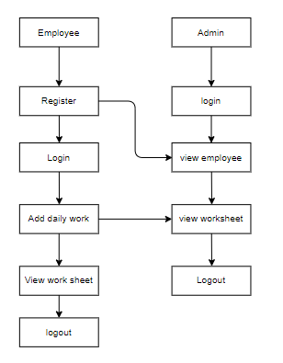
PROJECT FLLOW
Figure: work Flow of Proposed system

Slide 19
HARDWARE & SOFTWARE REQUIREMENTS
SOFTWARE REQUIREMENS
Operating System : Windows 7/8/10
Server side Script : HTML, CSS, Bootstrap & JS
Programming Language : JAVA
Libraries/Framework : Spring Boot
IDE/Workbench : Intellij IDEA

Slide 20
HARDWARE & SOFTWARE REQUIREMENTS
SOFTWARE REQUIREMENS
Technology : Java
Server Deployment : Tomacat Server
Database : MY SQL

Slide 21
HARDWARE & SOFTWARE REQUIREMENTS
HARDWARE REQUIREMENTS
Processor - I3/Intel Processor
RAM - 4GB (min)
Hard Disk - 128 GB
Key Board - Standard Windows Keyboard
Mouse - Two or Three Button Mouse
Monitor - Any

Slide 22
FUNCTIONAL AND NON-FUNCTIONAL REQUIREMENTS
Requirement’s analysis is very critical process that enables the success of a system or software project to be assessed. Requirements are generally split into two types: Functional and non-functional requirements.
Functional Requirements: These are the requirements that the end user specifically demands as basic facilities that the system should offer. All these functionalities need to be necessarily incorporated into the system as a part of the contract. These are represented or stated in the form of input to be given to the system, the operation performed and the output expected. They are basically the requirements stated by the user which one can see directly in the final product, unlike the non-functional requirements.

Slide 23
FUNCTIONAL AND NON-FUNCTIONAL REQUIREMENTS
Examples of functional requirements:
Authentication of user whenever he/she logs into the system
System shutdown in case of a cyber-attack
A verification email is sent to user whenever he/she register for the first time on some software system.
Non-functional requirements: These are basically the quality constraints that the system must satisfy according to the project contract. The priority or extent to which these factors are implemented varies from one project to other. They are also called non-behavioral requirements.

Slide 24
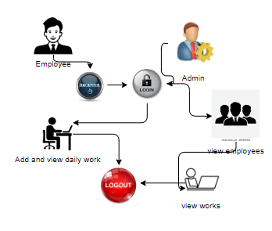
ARCHITECTURE

Slide 25
UML DIAGRAMS
Use Case Diagram:
A use case diagram in the Unified Modeling Language (UML) is a type of behavioral diagram defined by and created from a Use-case analysis. Its purpose is to present a graphical overview of the functionality provided by a system in terms of actors, their goals (represented as use cases), and any dependencies between those use cases. The main purpose of a use case diagram is to show what system functions are performed for which actor. Roles of the actors in the system can be depicted.

Slide 26
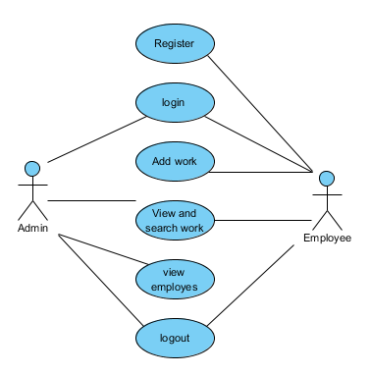
UML DIAGRAMS
Figure: Use Case Diagram

Slide 27
UML DIAGRAMS
Class Diagram:
In software engineering, a class diagram in the Unified Modelling Language (UML) is a type of static structure diagram that describes the structure of a system by showing the system's classes, their attributes, operations (or methods), and the relationships among the classes. It explains which class contains information.

Slide 28
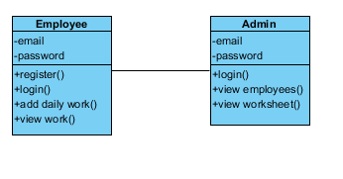
UML DIAGRAMS
Figure: Class diagram

Slide 29
UML DIAGRAMS
Sequence Diagram:
A sequence diagram in Unified Modelling Language (UML) is a kind of interaction diagram that shows how processes operate with one another and in what order. It is a construct of a Message Sequence Chart. Sequence diagrams are sometimes called event diagrams, event scenarios, and timing diagrams.

Slide 30
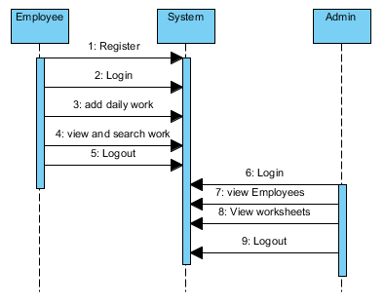
UML DIAGRAMS
Figure: Sequence diagram

Slide 31
UML DIAGRAMS
Collaboration Diagram:
In collaboration diagram the method call sequence is indicated by some numbering technique as shown below. The number indicates how the methods are called one after another. We have taken the same order management system to describe the collaboration diagram. The method calls are similar to that of a sequence diagram. But the difference is that the sequence diagram does not describe the object organization whereas the collaboration diagram shows the object organization.

Slide 32
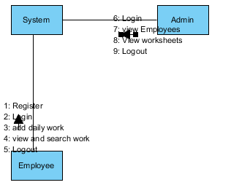
UML DIAGRAMS
Figure: Collaboration diagram

Slide 33
UML DIAGRAMS
Deployment Diagram
Deployment diagram represents the deployment view of a system. It is related to the component diagram. Because the components are deployed using the deployment diagrams. A deployment diagram consists of nodes. Nodes are nothing but physical hardware’s used to deploy the application.

Slide 34
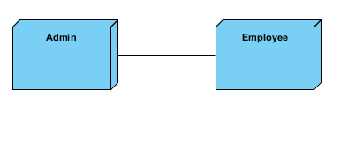
UML DIAGRAMS
Figure: Deployment diagram

Slide 35
UML DIAGRAMS
Activity Diagram:
Activity diagrams are graphical representations of workflows of stepwise activities and actions with support for choice, iteration and concurrency. In the Unified Modelling Language, activity diagrams can be used to describe the business and operational step-by-step workflows of components in a system. An activity diagram shows the overall flow of control.

Slide 36
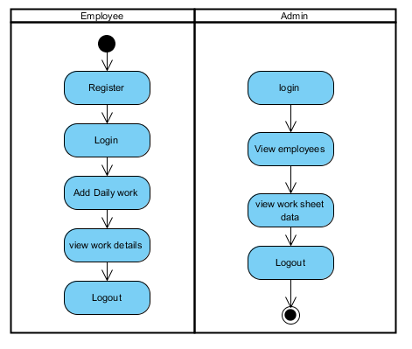
UML DIAGRAMS
Figure: Activity diagram

Slide 37
UML DIAGRAMS
Component Diagram:
A component diagram, also known as a UML component diagram, describes the organization and wiring of the physical components in a system. Component diagrams are often drawn to help model implementation details and double-check that every aspect of the system's required functions is covered by planned development.

Slide 38
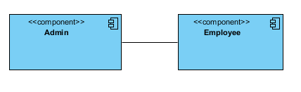
UML DIAGRAMS
Figure: Component diagram

Slide 39
UML DIAGRAMS
ER Diagram:
An Entity–relationship model (ER model) describes the structure of a database with the help of a diagram, which is known as Entity Relationship Diagram (ER Diagram). An ER model is a design or blueprint of a database that can later be implemented as a database. The main components of E-R model are: entity set and relationship set.
An ER diagram shows the relationship among entity sets. An entity set is a group of similar entities and these entities can have attributes. In terms of DBMS, an entity is a table or attribute of a table in database, so by showing relationship among tables and their attributes, ER diagram shows the complete logical structure of a database. Let’s have a look at a simple ER diagram to understand this concept.

Slide 40
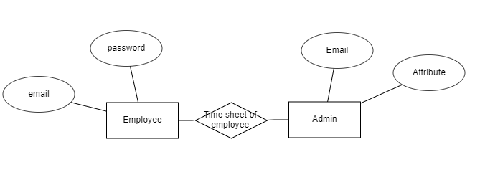
UML DIAGRAMS
Figure: ER diagram

Slide 41
UML DIAGRAMS
DFD Diagram:
A Data Flow Diagram (DFD) is a traditional way to visualize the information flows within a system. A neat and clear DFD can depict a good amount of the system requirements graphically. It can be manual, automated, or a combination of both. It shows how information enters and leaves the system, what changes the information and where information is stored. The purpose of a DFD is to show the scope and boundaries of a system as a whole. It may be used as a communications tool between a systems analyst and any person who plays a part in the system that acts as the starting point for redesigning a system.

Slide 42
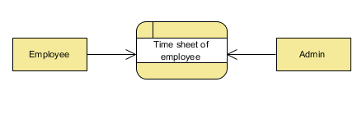
UML DIAGRAMS
Figure: Context Level diagram

Slide 43
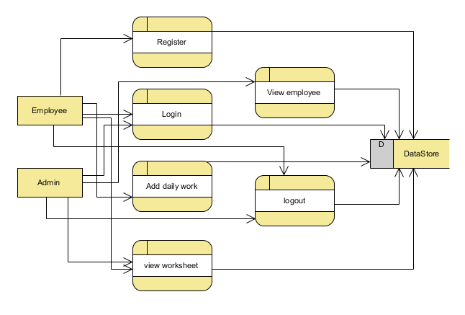
UML DIAGRAMS
FigureLevel-1 diagram

Slide 44
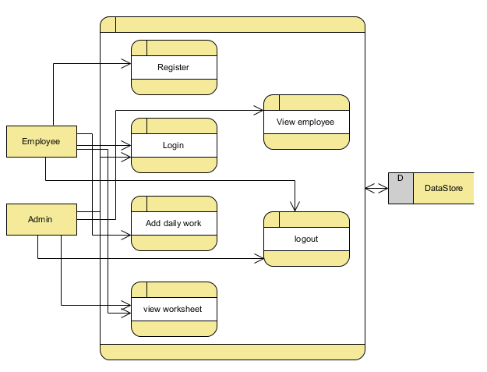
UML DIAGRAMS
Figure:Level-2 diagram

Slide 45
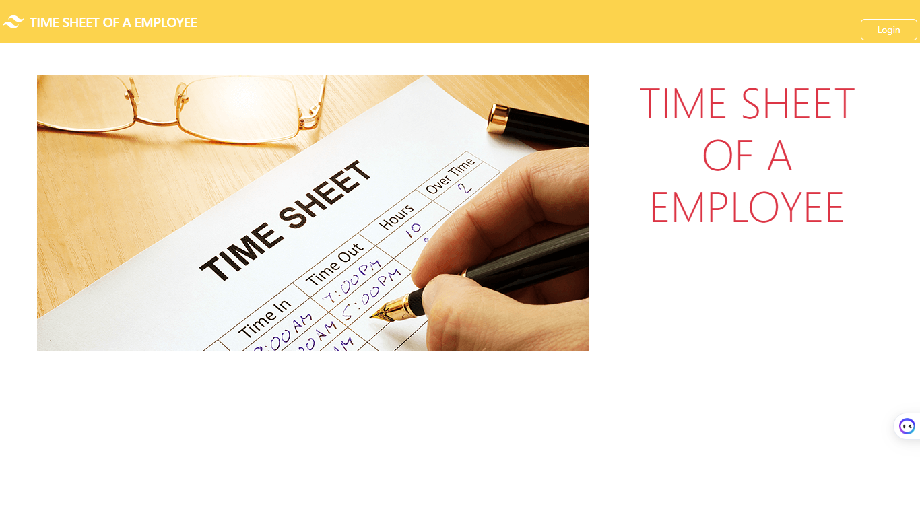
OUTPUT SCREENS
Home page: This is the home page.

Slide 46
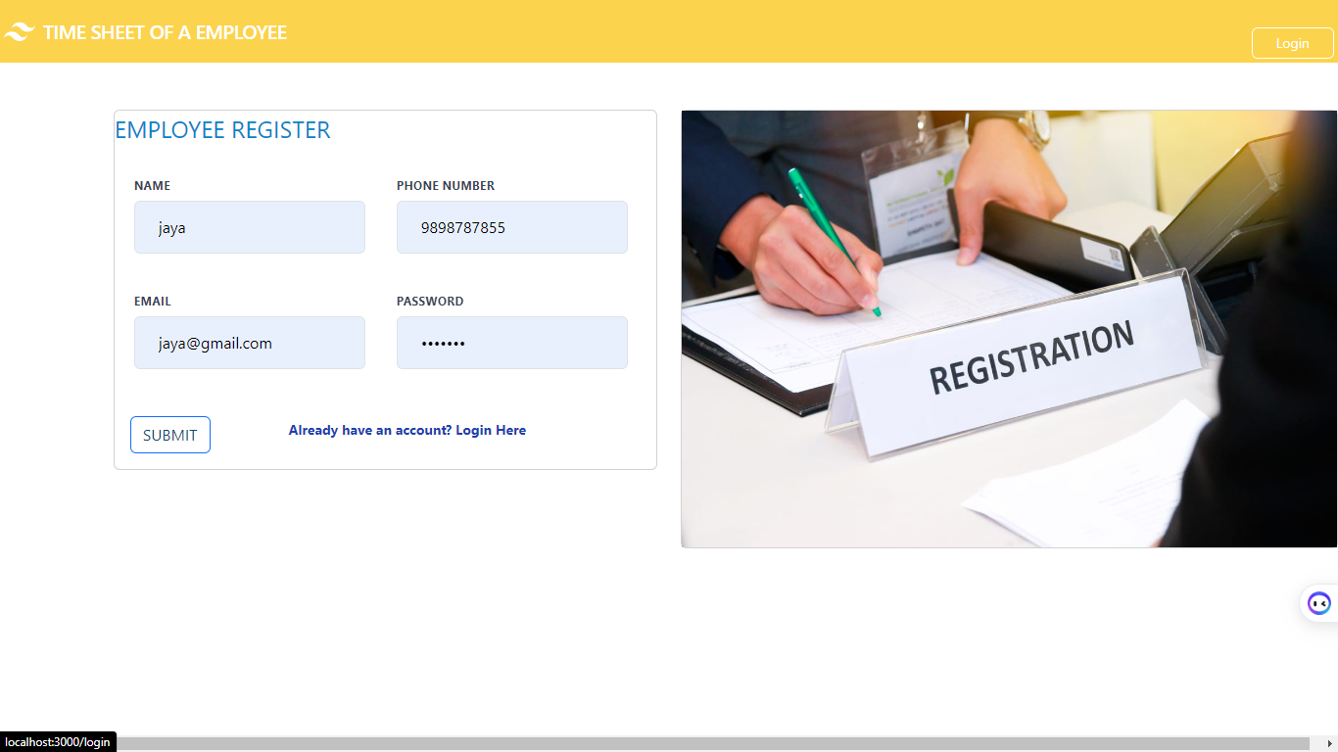
OUTPUT SCREENS
Register Page: This is the registration page for employee

Slide 47
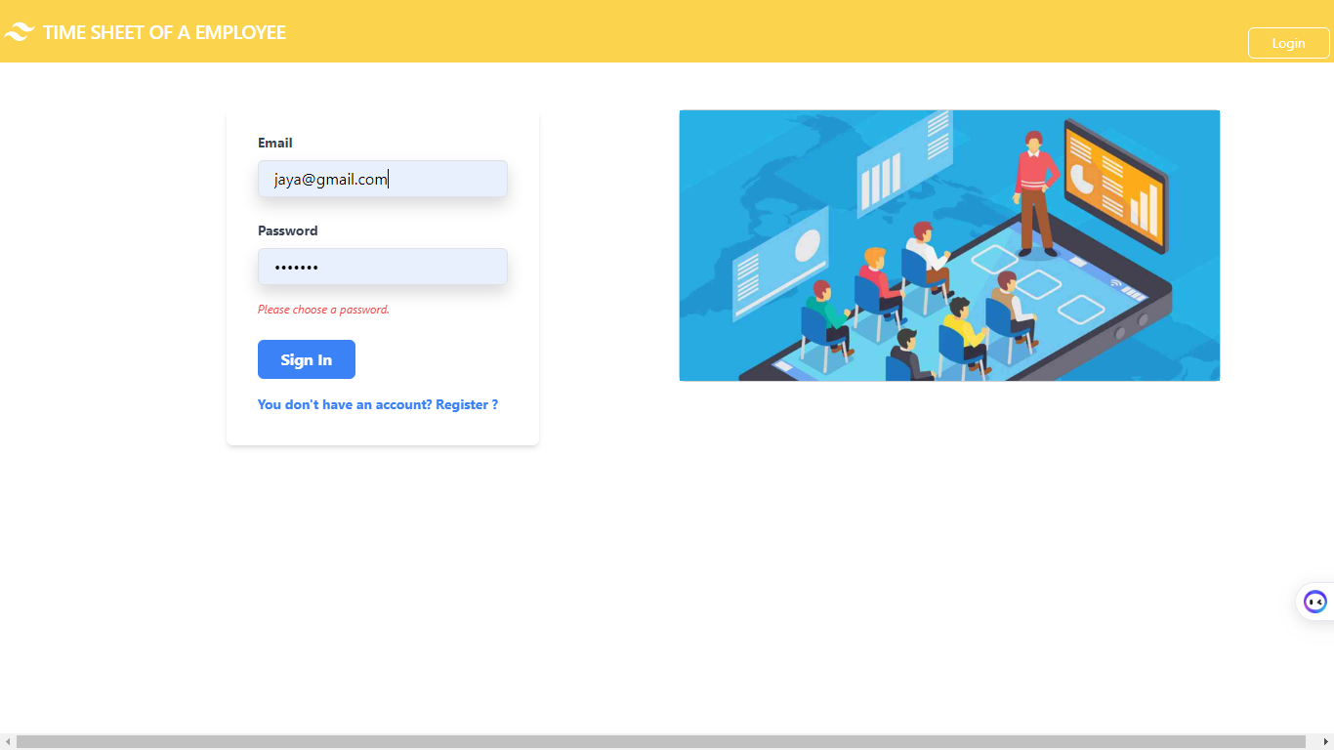
OUTPUT SCREENS
Login Page: This is the login page for both employee and admin

Slide 48
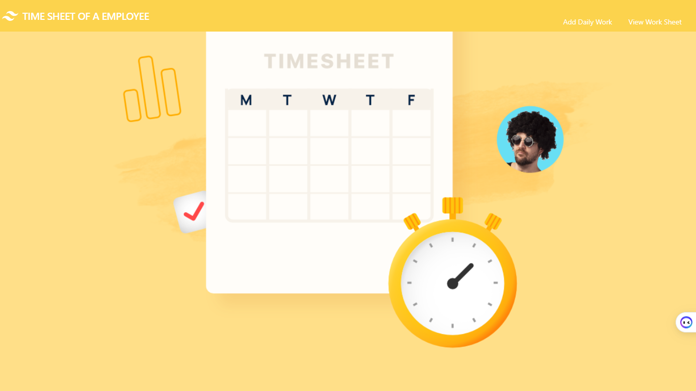
OUTPUT SCREENS
Employee Home :This is the home page for employee

Slide 49
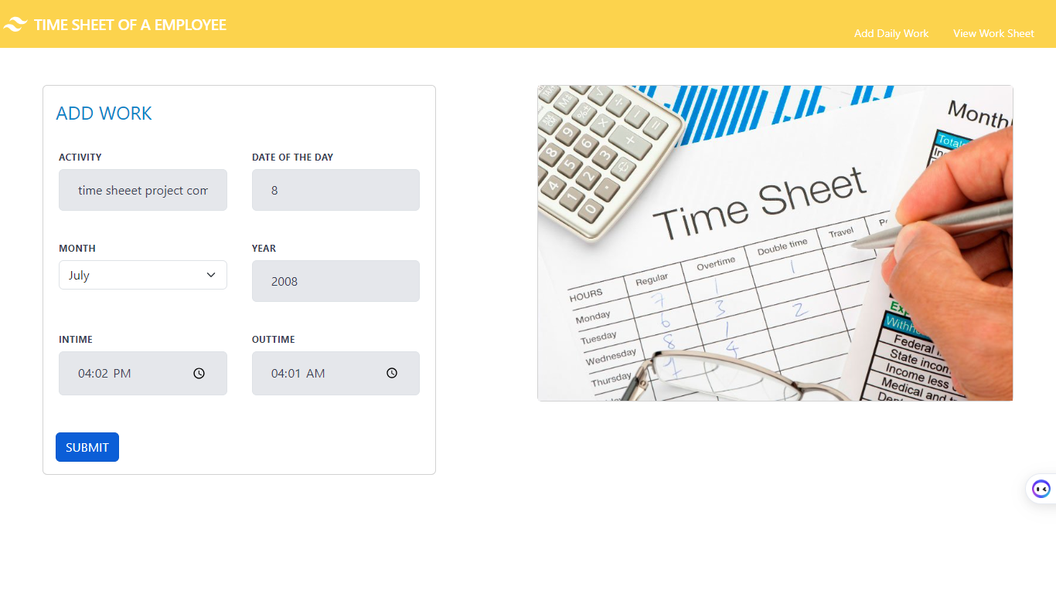
OUTPUT SCREENS
View Work Sheet: Employee can view their work sheet

Slide 50
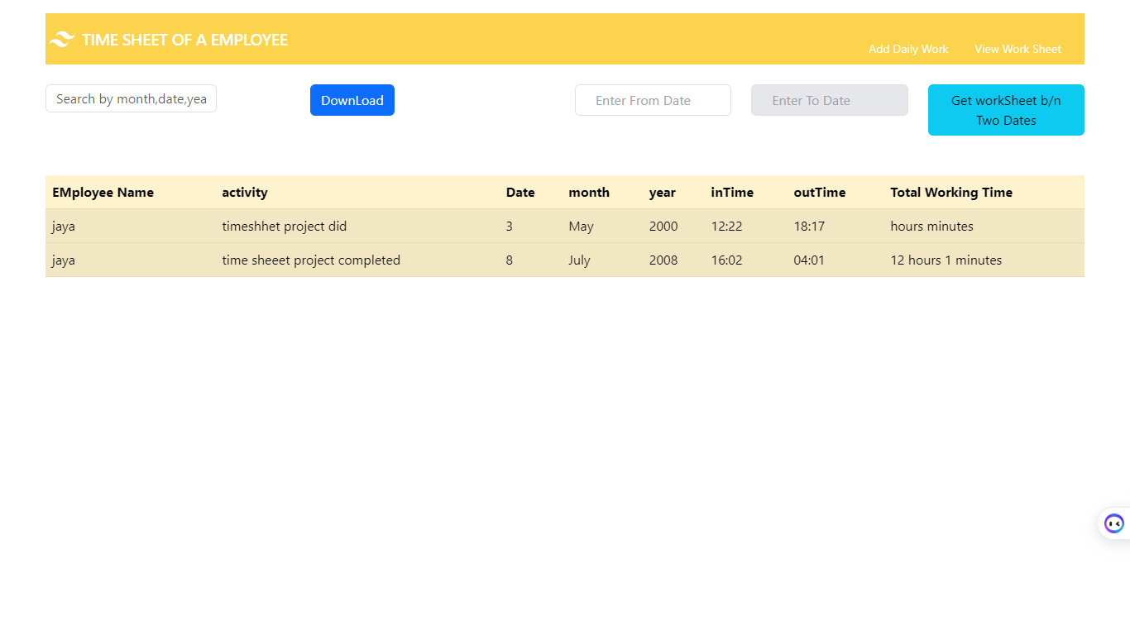
OUTPUT SCREENS
View Work Sheet: Employee can view their work sheet

Slide 51
CONCLUSION
Employee management system is the way for today's dynamic and competitive business landscape, managing employees effectively is crucial for the success of any organization. As companies grow in size and complexity, traditional manual approaches to employee management become increasingly challenging and time-consuming. This is where an Employee Management System comes into play.

Slide 52
FUTURE ENHANCEMENT
In the future, employee management systems are likely to incorporate several enhancements to improve efficiency, productivity, and employee satisfaction. Here are some potential future enhancements for an employee management system:
Artificial Intelligence (AI) Integration: AI can be utilized to automate repetitive tasks, such as data entry, leave management, and timesheet tracking. It can also provide insights and recommendations for performance management, employee engagement, and training needs.
Predictive Analytics: By leveraging historical data and AI algorithms, employee management systems can predict trends and patterns related to employee performance, turnover, and engagement. This information can help organizations proactively address potential issues and make data-driven decisions.
.

Slide 53
CONCLUSION
In conclusion, employee time sheets play a crucial role in tracking and managing work hours, ensuring accurate compensation, and providing valuable insights into productivity and resource allocation. By leveraging technology and implementing future enhancements, organizations can improve the efficiency, accuracy, and user experience of time sheet systems. Ultimately, a user-friendly interface is essential for a successful time sheet system, allowing employees to easily record their hours and reducing the likelihood of errors. By implementing these future enhancements, organizations can optimize their time tracking processes, improve accuracy, and enhance overall productivity and efficiency in managing employee work hours

Slide 54
FUTURE ENHANCEMENT
In the future, there are several possible enhancements that could be implemented for employee time sheets to improve efficiency, accuracy, and overall user experience. Here are a few potential ideas:
Automated Time Tracking: Introduce automated time tracking systems that use advanced technologies like biometric recognition, location tracking, or activity monitoring to capture and record employees' work hours accurately. This reduces the reliance on manual input and minimizes errors or intentional manipulation.
Mobile and Wearable Integration: Develop dedicated mobile applications or integrate time tracking features into wearable devices, such as smartwatches or fitness trackers. This enables employees to easily track their work hours on the go, increasing flexibility and accessibility.

Slide 55
REFERENCES
[1] Smith, J., Johnson, A., Williams, L., "A Systematic Review of Employee Management Systems: Features, Challenges, and Benefits", Journal of Human Resources Management, 2019
[2] Brown, M., Davis, R., Thompson, S, "The Impact of Employee Management Systems on Organizational Performance" ,International Journal of Business Studies, 2018
[3] Chen, H., Li, Q., Wang, Y, "Exploring Employee Self-Service Features in Employee Management Systems", Information Systems Research, 2020
[4] Gupta, R., Sharma, S., Kumar, A, "Implementation Strategies for Employee Management Systems: A Case Study Analysis", Journal of Strategic HR Management, 2021
[5] Lee, E., Park, S., Kim, J, "Security and Privacy Considerations in Employee Management Systems", International Journal of Information Security, 2022

Slide 56
REFERENCES
[6] Mitchell, L., Turner, K., Parker, S, "The Role of Employee Management Systems in Talent Development and Succession Planning", Journal of Organizational Development, 2019
[7] – Begg Carolyn, Connolly Thomas, Database systems (a Practical approach to Design, Implementation, and Management), Addison-Wesley, an imprint of Pearson Education, University of Paisley (U.K.), Fourth edition 2005
[8] – Bodnar George /Duquesne University/, Hopwood William /Florida Atlantic University/, Accounting Information systems, Eighth Edition, Prentice Hall, Upper Saddle River, New Jersey .
[9] – Andersen Virginia, Access 2000: The Complete Reference, Blacklick, OH, USA: McGraw-Hill Professional Book Group, 2001, http://site.ebrary.com/lib/vaxjo/Doc?id=5002842 (2006-05-25).
[10] – Andersson Tobias, [DAB744] C# Course Lectures, School of Mathematics and System Engineering, Växjö University.

